Slide 1

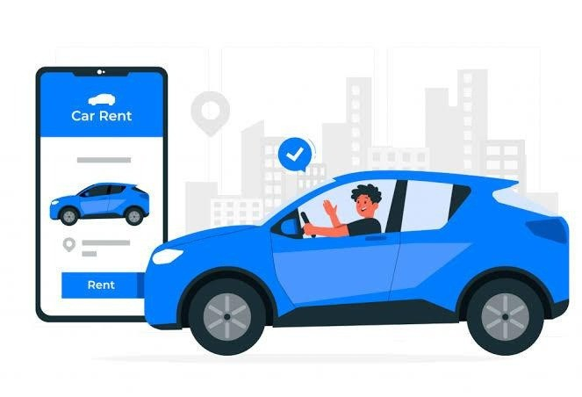
RENTAL CAR MANAGEMEN SYSTEM
NAME : JESWIN .M , RAAHIL HASSAN
REG.NO : RA2311047010043, RA2311047010010

Slide 2
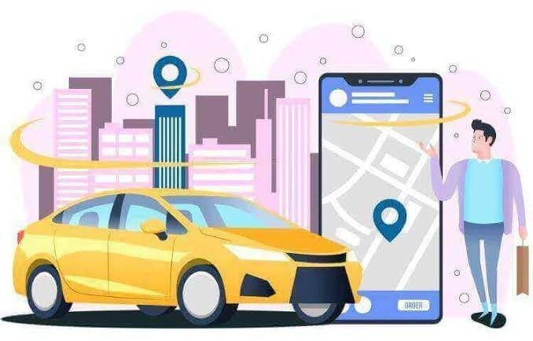

INTRODUCTION
A Car Rental Management System automates vehicle rentals, streamlining reservations, payments, and fleet management to enhance efficiency and customer experience.

Slide 3
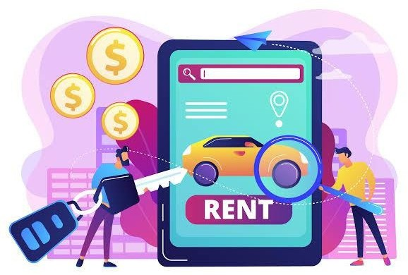
PROBLEM STATEMENT
Manual rental processes lead to booking errors, poor tracking, and inefficiency.
This system solves these issues with automation, real-time tracking, and better management.

Slide 4
ENTITIES AND THEIR IDENTIFICATION
Customer : ( CustomerID, Name, Address, Phone Number, Email, and Driver’s License Number ).
Car : ( CarID, Make, Model, Year, Color, Registration Number, Daily Rental Rate, and Status (Available/Rented) ).
Reservation : ( ReservationID, CustomerID, CarID, Reservation Date, Pickup Date, Return Date, and
Status ).
Rental : ( RentalID, ReservationID, Rental Date, Return Date, Total Cost, CustomerID, and CarID ).
Payment : ( PaymentID, RentalID, Payment Date, Amount, and Payment Method ).
Employee : ( EmployeeID, Name, Job Title, Phone Number, and Email ).
Branch : ( BranchID, Branch Name, Location (Address, City, State), and Contact Number ).
Car Type : ( CarTypeID, Type (e.g., Sedan, SUV, Convertible), and Description ).
Car Model : ( ModelID, Make, Model Name, and Year ).
Insurance : ( InsuranceID, CarID, Policy Number, Insurance Type, and Coverage Amount ).
Damage Report : (DamageReportID, CarID, Date Reported, Description, and Cost of Repair). 12.Maintenance : ( MaintenanceID, CarID, Service Date, Service Type, Service Details, and Cost ). 13.Discount : ( DiscountID, Description, Discount Percentage, Start Date, and End Date ).
Feedback : ( FeedbackID, CustomerID, Rating, Comments, and Date ).
Vehicle Availability : ( CarID, Date, and Availability Status (Available, Booked, In Service) ).
4

Slide 5
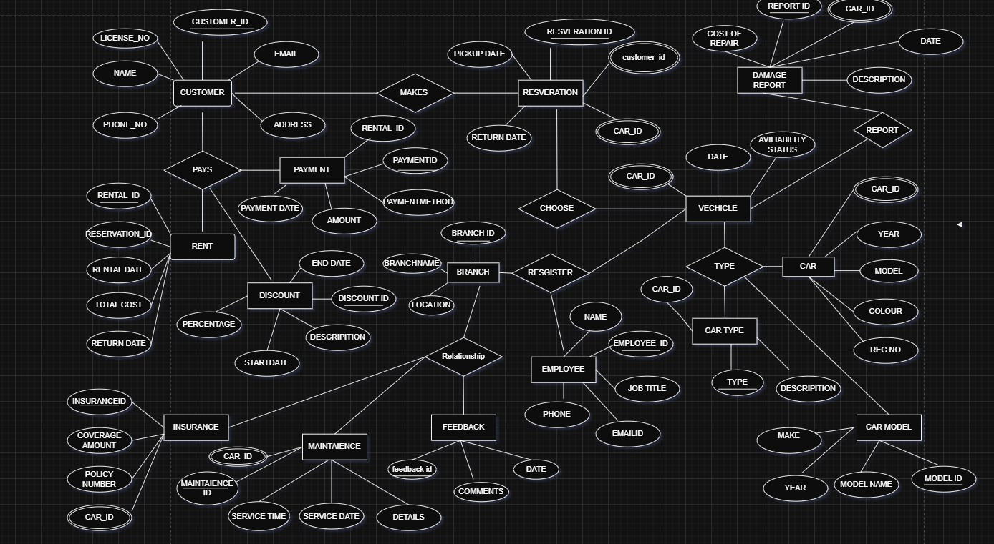
ER DIAGRAM
5

Slide 6
RELATIONSHIPS WITH CARDINALITIES
Here are the relationships with cardinalities for all 15 entities in the Car Rental Management System:
Customer to Reservation:
One-to-Many: 1 Customer → Many Reservations
Car to Reservation:
One-to-Many: 1 Car → Many Reservations
Reservation to Rental:
One-to-One: 1 Reservation → 1 Rental
Rental to Payment:
One-to-Many: 1 Rental → Many Payments
Employee to Rental:
One-to-Many: 1 Employee → Many Rentals
Branch to Employee:
One-to-Many: 1 Branch → Many Employees
Car Type to Car:
One-to-Many: 1 Car Type → Many Cars
Car Model to Car:
One-to-Many: 1 Car Model → Many Cars
Car to Insurance:
One-to-One: 1 Car → 1 Insurance
Car to Damage Report:
One-to-Many: 1 Car → Many Damage Reports
Car to Maintenance:
One-to-Many: 1 Car → Many Maintenance Records
Discount to Reservation:
One-to-Many: 1 Discount → Many Reservations (if applicable)
Customer to Feedback:
One-to-Many: 1 Customer → Many Feedbacks
Car to Feedback:
One-to-Many: 1 Car → Many Feedbacks
Car to Vehicle Availability:
One-to-Many: 1 Car → Many Vehicle Availability Records
6

Slide 7
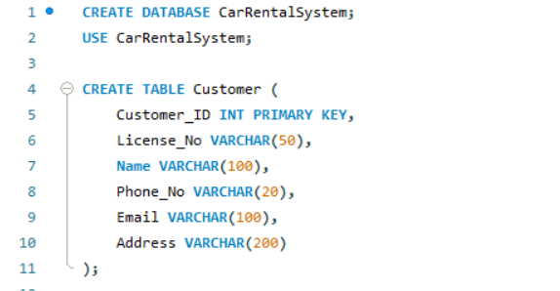
Customer Table Creation

Slide 8
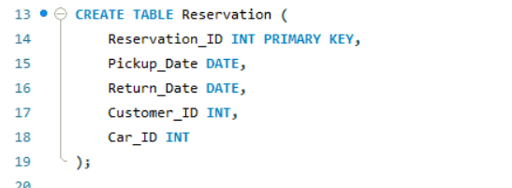
Reservation Table Creation

Slide 9
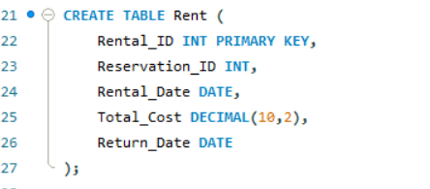
Rent Table Creation

Slide 10
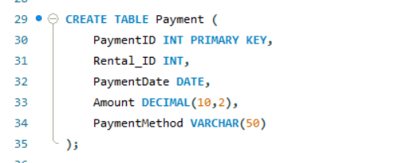
Payment Table Creation

Slide 11
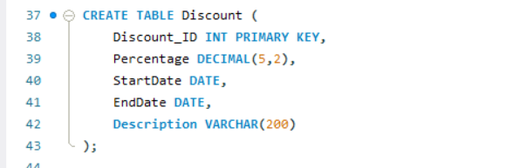
Discount Table Creation

Slide 12
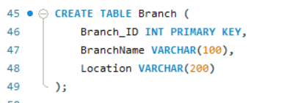
Branch Table Creation

Slide 13
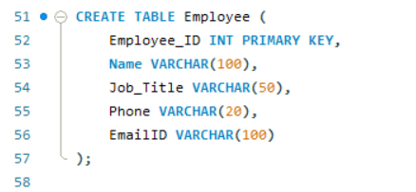
Employee Table Creation

Slide 14
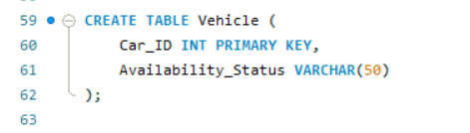
Vehicle Table Creation

Slide 15
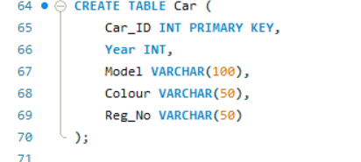
Car Table Creation

Slide 16
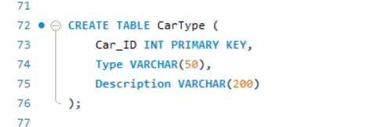
Car Type Table Creation

Slide 17
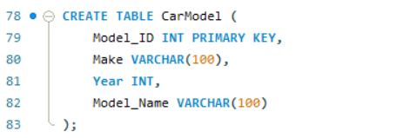
Car Model Table Creation

Slide 18
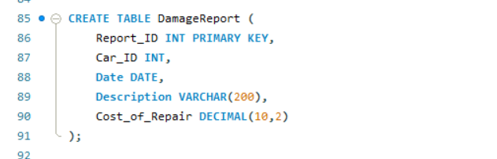
Damage Report Table Creation

Slide 19
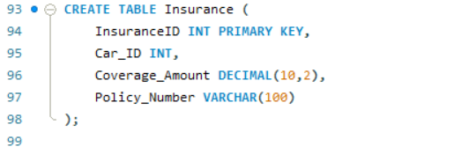
Insurance Table Creation

Slide 20
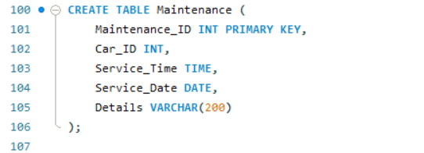
Maintenance Table Creation

Slide 21
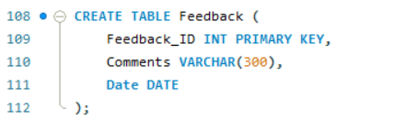
Feedback Table Creation

Slide 22
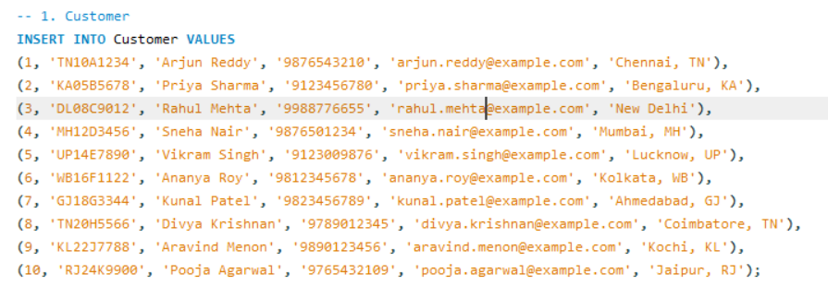
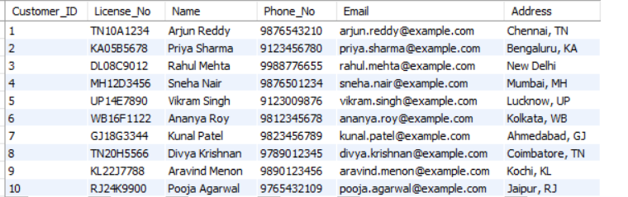
Insert Values - Customer

Slide 23
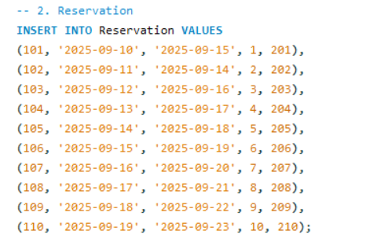
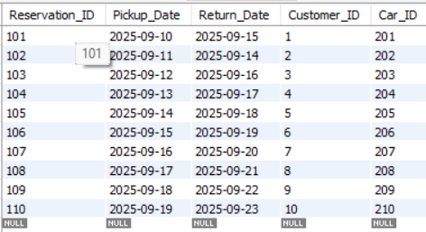
Insert Values - Reservation

Slide 24
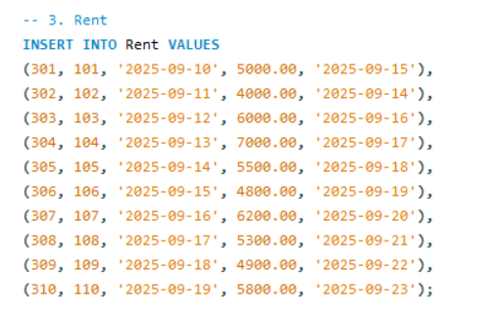
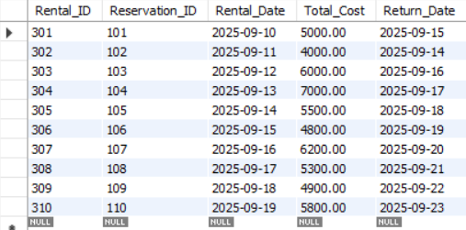
Insert Values - Rent

Slide 25
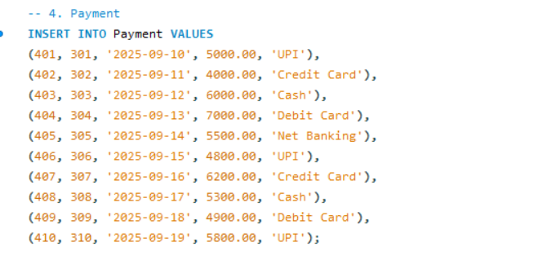
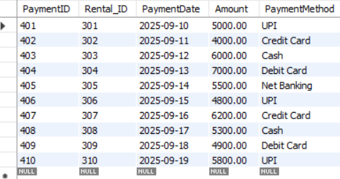
Insert Values - Payment

Slide 26
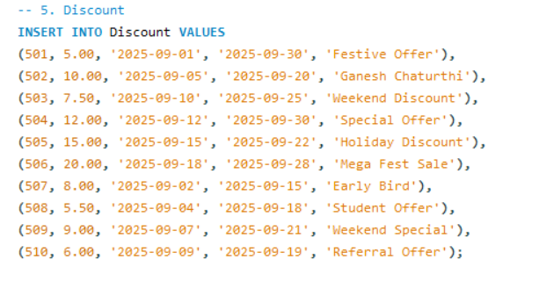
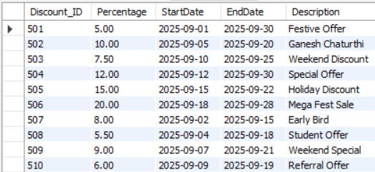
Insert Values - Discount

Slide 27
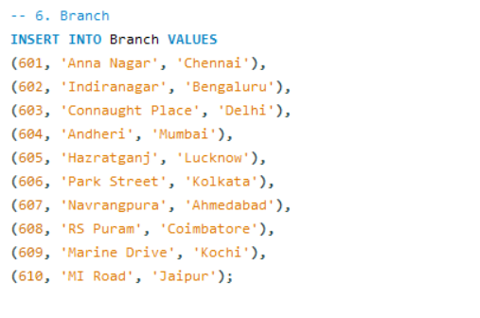
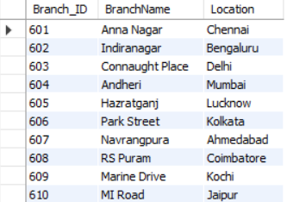
Insert Values - Branch

Slide 28
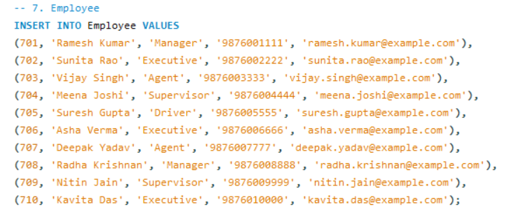
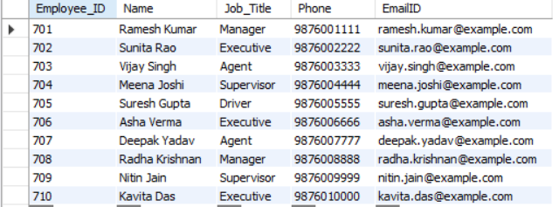
Insert Values - Employee

Slide 29
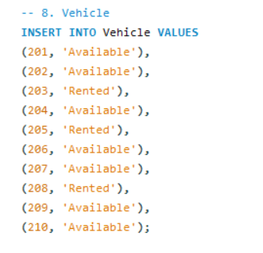
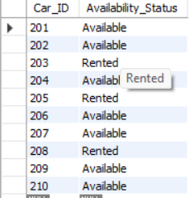
Insert Values - Vehicle

Slide 30
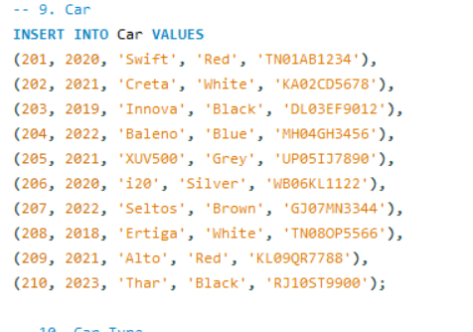
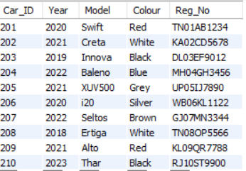
Insert Values - Car

Slide 31
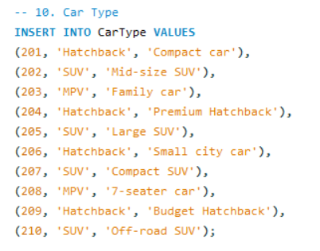
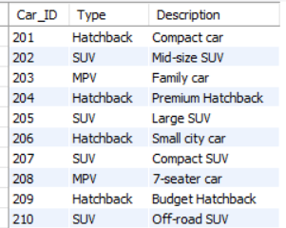
Insert Values – Car Type

Slide 32
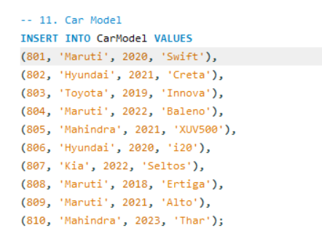
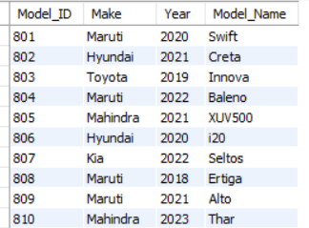
Insert Values – Car Model

Slide 33
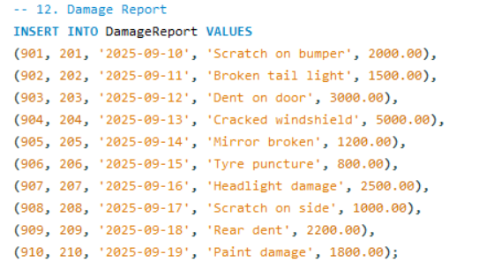
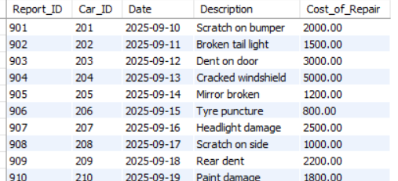
Insert Values – Damage Report

Slide 34
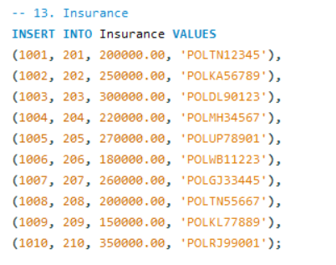
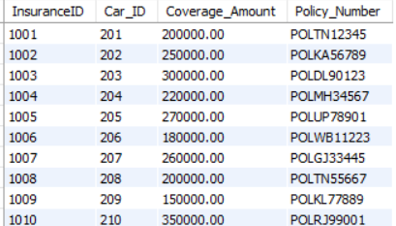
Insert Values – Insurance

Slide 35
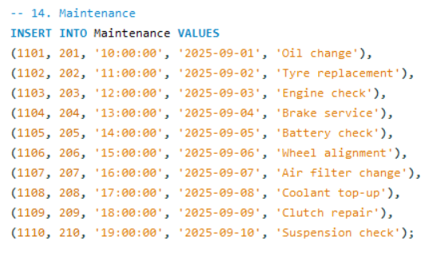
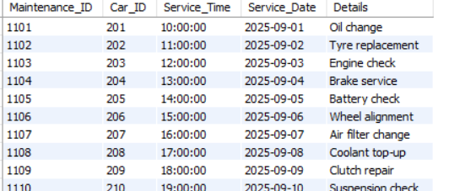
Insert Values - Maintenance

Slide 36
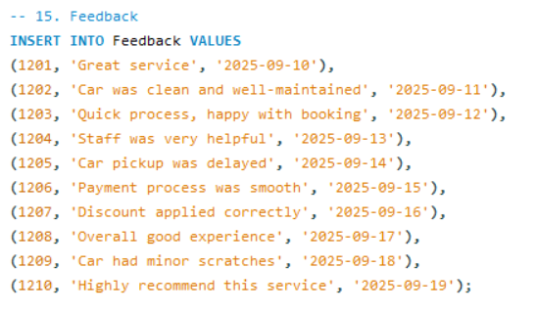
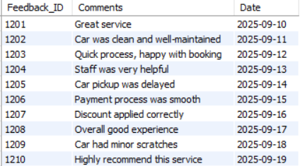
Insert Values - Feedback

Slide 37
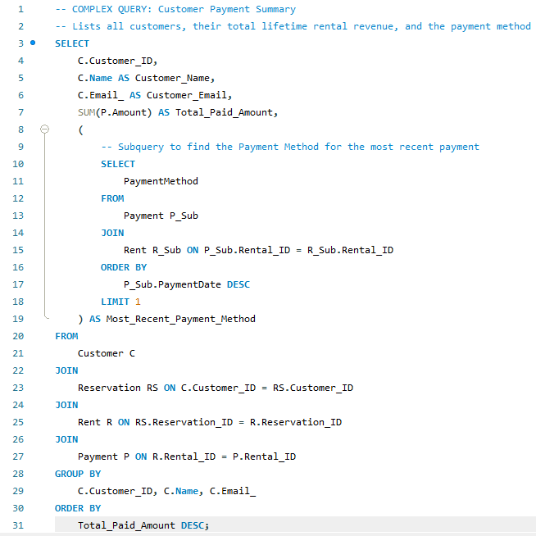

Complex Queries
A general complex query often involves multiple joins, filtering, and aggregation.
This query calculates the total amount paid by each customer and identifies the method they used most recently.

Slide 38



Complex Queries

Slide 39



Complex Queries

Slide 40


SET OPERATION (UNION)
his query uses the UNION set operator to combine a list of cars that are currently 'Rented' with cars that have an
'Oil change' maintenance detail, providing a list of all currently occupied or recently serviced cars.

Slide 41


JOINS
This is a classic multi-table join to retrieve the maximum possible details about a specific rental event.

Slide 42


JOINS
Since your original query already had a LEFT JOIN, I'll rewrite the query to focus on all cars,
including those that have never been rented, showing the value of the LEFT JOIN for completeness.

Slide 43


Views
Creates a view for aggregating monthly revenue and rental counts.

Slide 44


Views
Vehicle Health Report

Slide 45



Triggers
This trigger automatically updates a car's Availability_Status to 'Rented' in the Vehicle
table immediately after a new rental record is successfully inserted into the Rent table.

Slide 46



CURSOR
A cursor is implemented inside a stored procedure to iterate through the results of a query.
This example creates a stored procedure that uses a cursor to iterate over
all DamageReport entries and summarize the total repair cost.

Slide 47

DATABASE NORMALIZATION - 1 NF
It uses a composite primary key of (Customer_ID, Car_ID, Rental_Date)
but contains partial and transitive dependencies, which normalization fixes.
A table is in 1NF if and only if:
There are no repeating groups of data (each cell contains only one value).
Each column has a unique name.
The data is atomic (values cannot be further broken down).

Slide 48

DATABASE NORMALIZATION - 2 NF
Partial Dependencies in 1NF Table
Car_Make and Daily_Rate depend only on Car_ID (a part of the PK).
Customer_Name depends only on Customer_ID (a part of the PK).
To achieve 2NF, we split the table into three: CUSTOMER, CAR,
and RENTAL_RECORD_2NF.
A table is in 2NF if and only if:
It is in 1NF.
All non-key attributes are fully dependent on the entire primary key.
This form resolves partial dependencies.

Slide 49

DATABASE NORMALIZATION - 3 NF
Transitive Dependency in 2NF Table
The RENTAL_RECORD_2NF table contains the non-key attributes Branch_ID and Branch_Location.
Branch_ID > Branch_Location (The Branch Location depends on the Branch ID, which is a non-key attribute in this table).
To achieve 3NF, we split RENTAL_RECORD_2NF into two tables: BRANCH and the final RENTAL_RECORD_3NF.
A table is in 3NF if and only if:
It is in 2NF.
It contains no transitive dependencies. A transitive dependency occurs
when a non-key attribute depends on another non-key attribute.

Slide 50




DCL (Data Control Language)
Used to control access to data in a database — manages privileges and permissions.
2. The GRANT command allows the specified user to access or modify data.
The REVOKE command withdraws those rights

Slide 51


TCL (Transaction Control Language)
Used to manage changes made by DML statements
(INSERT, UPDATE, DELETE) and control the execution of transactions

Slide 52






TCL (Transaction Control Language)
Output :

Slide 53
Conclusion
The system successfully manages 15 interconnected tables covering customers, reservations, payments, cars, employees, and services.
Customer and reservation tracking ensures smooth booking, rental, and return processes.
The payment and discount modules make financial transactions transparent and flexible.
Vehicle, car, insurance, and maintenance tables guarantee safety, reliability, and up-to-date records of assets.
Branch and employee management supports multi-location operations with assigned staff roles.
Feedback and damage reports enable service improvement and accountability.
Overall, the database provides a comprehensive, scalable, and efficient framework for managing a modern car rental business.

